Slide 1
Python in ETL
Deepak Rayathurai

Slide 2
Contents
Introduction of ETL
Packages in python
Brief Introduction
Queries

Slide 3
Introduction
ETL is the process of fetching data from one or many systems and loading it into a target data warehouse after doing some intermediate transformations. The market has various ETL tools that can carry out this process.

Slide 4

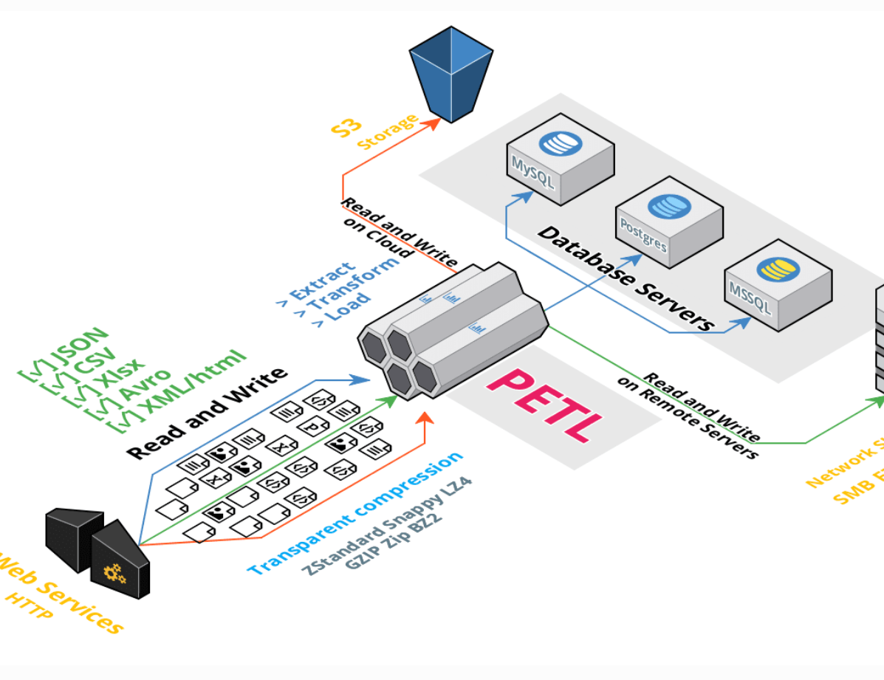
PETL
Petl (stands for Python ETL) is a basic tool that offers the standard ETL functionality of importing data from different sources (like csv, XML, json, text, xls) into your database. It is trivial in terms of features and does not offer data analytics capabilities like some other tools in the list. However, it does support all the standard transformations like row operation, sorting, joining, and aggregation.

Slide 5
Pandas
Pandas is one of the most popular Python libraries nowadays and is a personal favorite of mine. I’ve used it to process hydrology data, astrophysics data, and drone data. Its rise in popularity is largely due to its use in data science, which is a fast-growing field in itself, and is how I first encountered it.

Slide 6
Mara
Mara is a Python ETL tool that is lightweight but still offers the standard features for creating an ETL pipeline. It also offers other built-in features like web-based UI and command line integration. Web UI helps to visualize the ETL pipeline execution, which can also be integrated into a Flask based app. It uses PostgreSQL as the data processing engine.

Slide 7
Airflow
Apache Airflow was created by Airbnb and is an open source workflow management tool. It can be used to create data ETL pipelines. Strictly speaking, it is not an ETL tool itself, instead, it is more of an orchestration tool that can be used to create, schedule, and monitor workflows. This means you can use Airflow to create a pipeline by consolidating various independently written modules of your ETL process.

Slide 8
Pyspark
Pyspark is the version of Spark which runs on Python and hence the name. As per their website, “Spark is a unified analytics engine for large-scale data processing.”

Slide 9
Bonobo
Bonobo is a lightweight ETL tool built using Python. It is simple and relatively easy to learn. It uses the graph concept to create pipelines and also supports the parallel processing of multiple elements in the pipeline. It also has a visual interface where the user can track the progress of the ETL pipeline.

Slide 10
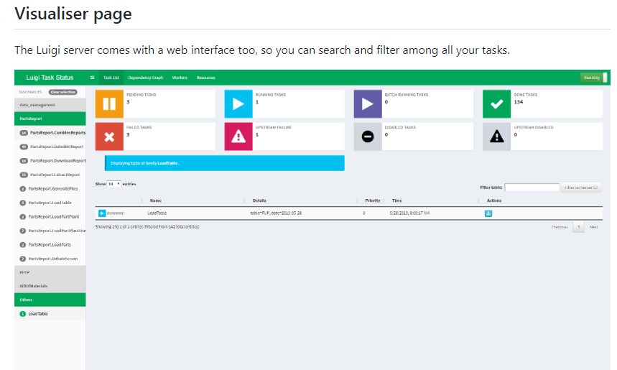
Luigi
Luigi is a Python-based ETL tool that was created by Spotify but now is available as an open-source tool. It is a more sophisticated tool than many on this list and has powerful features for creating complex ETL pipelines. As per their Github page, “It handles dependency resolution, workflow management, visualization, handling failures, command line integration, and much more”

Slide 11

Queries

